Slide 1
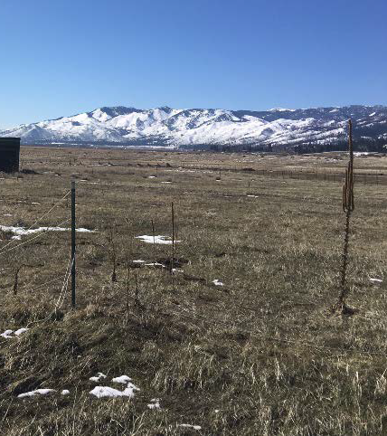
Special Use Permit WSUP17-0005
Washoe County
Board of Adjustment
June 1, 2017
Old Ophir Ranch

Slide 2
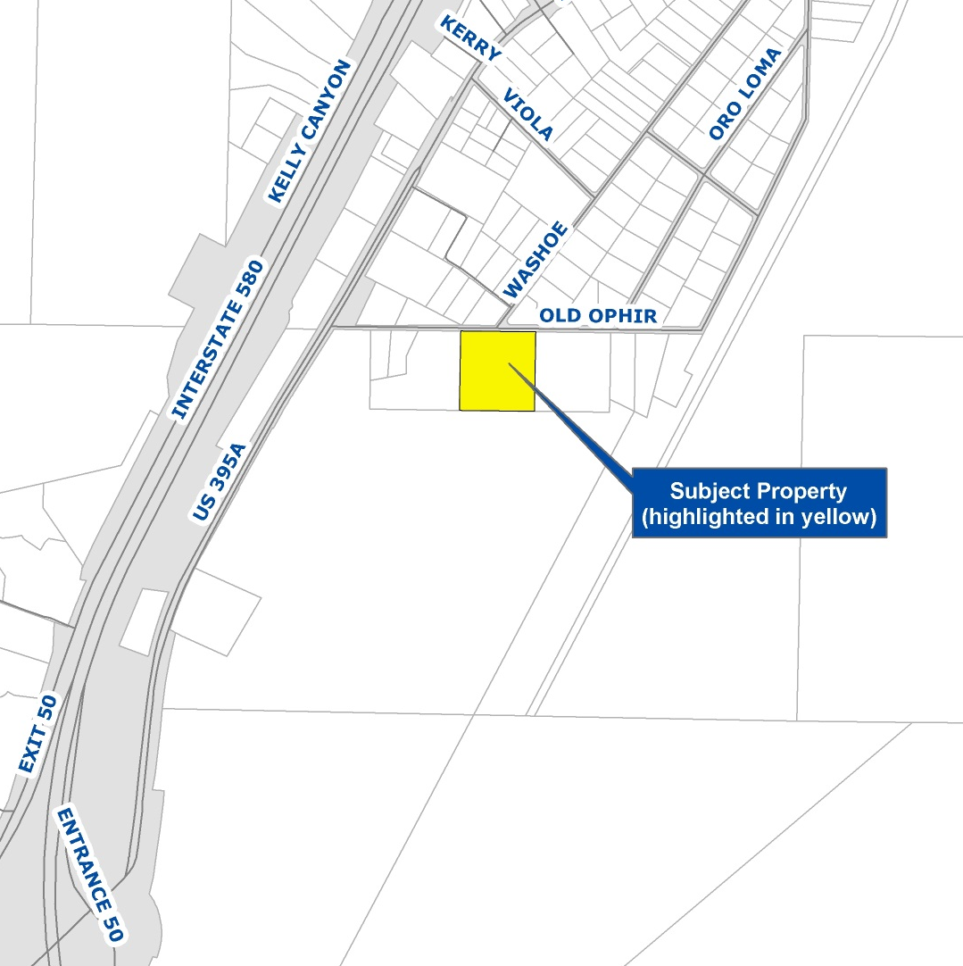
Vicinity Map
South Valleys Area Plan
East of Old 395, off Washoe Drive
Low Density Suburban
6.41-acres

Slide 3
Overview of Request
Commercial boarding for up to 20 horses (plus owner’s 6 horses)
Reduce parking and landscaping standards
3 phases of development
Hours: 7 -7 (employees); 8-5 (visitors)

Slide 4
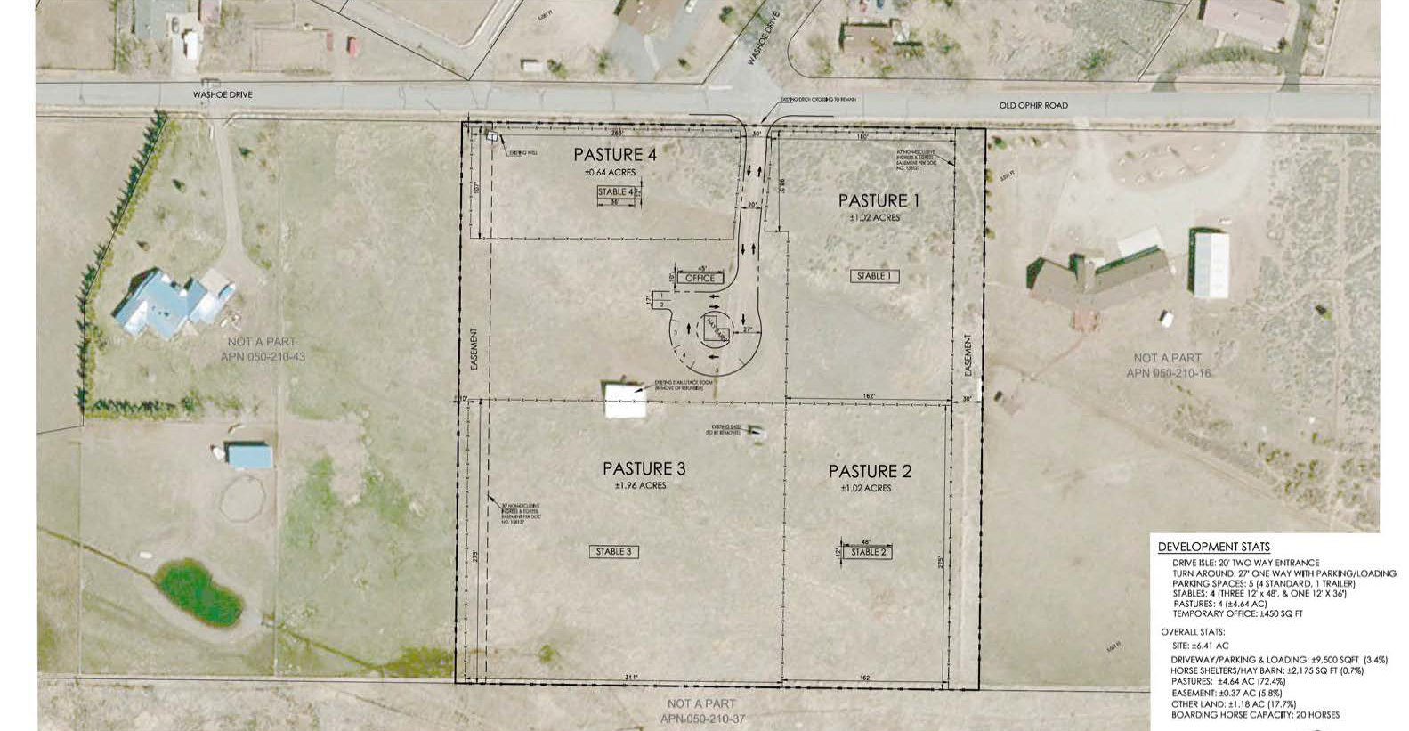
Phase 1
Notes:
Phase 1 includes:
Construction of a hay barn, pasture areas, and four stables
Driveway, temporary office, parking areas and landscaping
Each of the four pasture areas would contain a 430-580 sq ft stable.
20-foot-wide driveway would connect to a 27-foot-wide, single-direction driveway loop to provide area for parking and turn-arounds.
440 sq. ft. hay barn placed in the center of driveway loop
Phase 1 anticipated to be completed within 1 year from date of approval.

Slide 5
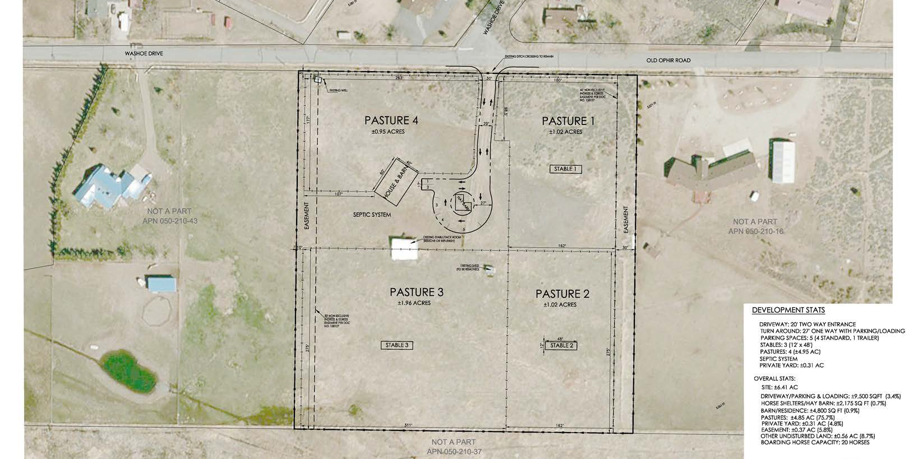
Phase 2
Notes:
Phase 2 includes:
construction of a septic system, permanent residence and attached commercial space.
4,800 sq. ft. Structure would have barn, small commercial office and restroom on 1st floor, with a residence on the second floor.
Phase 2 anticipated to be completed 18-36 months from date of approval
Once Phase 2 is complete, temporary commercial structure and portable toilets will be removed

Slide 6
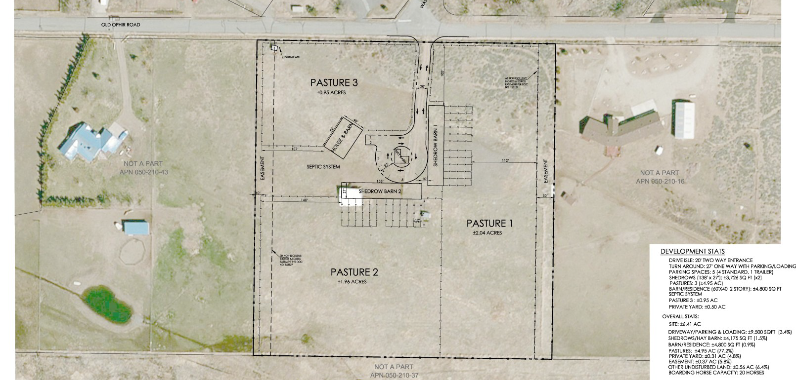
Phase 3
Notes:
Phase 3 includes:
construction of two shedrow barns (each 3,726 sq ft)
This phase includes removal of the smaller stables placed in each pasture during Phase 1.
IMPORTANT TO NOTE ABOUT PHASING: (from staff report)
The proposed phasing of the project introduces uncertainties in terms of allowing for a
commercial use to be established onsite prior to a permanent commercial structure and septic
system being completed. To reduce the likelihood of the operation continuing without these
necessities in place, staff recommends that this special use permit be brought back before the
Board of Adjustment for review within 40 months from the date of approval. This subsequent
review will allow for staff and the Board to ensure conditions of approval have been met and
evaluate whether it is appropriate to continue the proposed use if the second phase of the
project has not yet been completed. Since Phase 2 is proposed to be completed 18-36 months
from date of special use permit approval, 40 months should provide adequate time to allow for
completion of Phase 2 prior to bringing this item back to the Board.

Slide 7
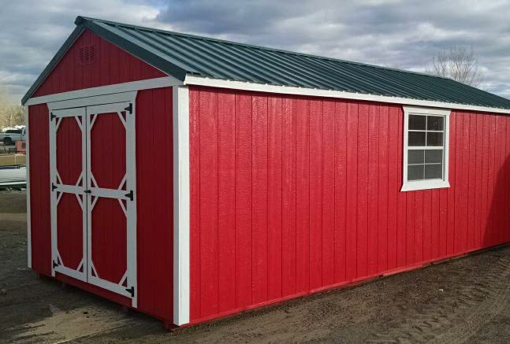
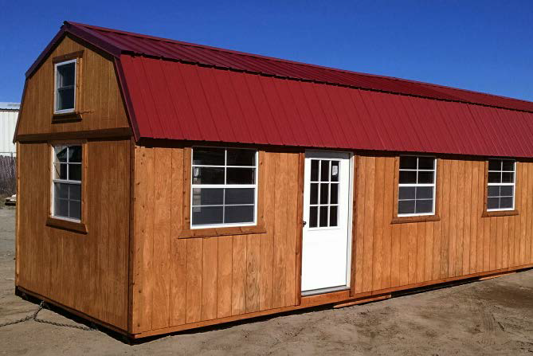
Temporary Commercial Structure
450 sq. ft. office
Portable restroom facilities
In place only until Phase 2 complete
Notes:
Applicant seeks to begin boarding horses once Phase 1 is complete. However, Code requires all commercial uses operate from a commercial structure.
To address this requirement, applicant will establish a 450 sq ft temporary commercial structure onsite until permanent residence and commercial structure are completed.
Until Phase 2 is complete, onsite restroom facilities will be portable toilets.
Conditions of approval govern frequency of waste removal
(pictures are examples of type of structure applicant will use)

Slide 8
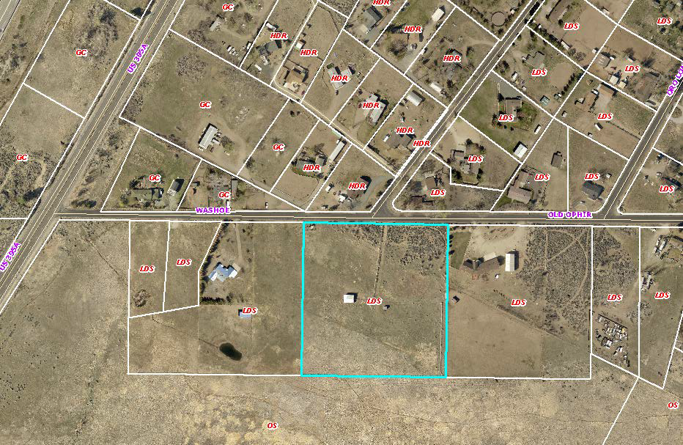
Compatibility
Notes:
Parcel is LDS
LDS east/west
OS public land to south
HDR and GC across the street (GC developed as residential)
Notes: The South Valleys Area Plan explicitly places a high value on equestrian uses in the area and the maintenance of a rural lifestyle that supports this type of use.

Slide 9
Parking and Landscaping Requests
Parking standards:
  Reduce parking from 6 spots to 5
  Use D.G. instead of paved driveway/parking
Landscaping standards:
  Change solid decorative wall to open fencing
  Reduce trees from 1 per 20 ft. to 1 per 40 ft.
Notes:
Reduce parking from 6 spots to 5
SUPPORT
Use D.G. instead of paved driveway/parking
PARTIALLY SUPPORT: ok everywhere except handicapped parking
Landscaping standards are for buffering adjacent residential uses from this commercial use
Change solid decorative wall to open fencing
SUPPORT: also supported by South Valleys Area Plan policies
Reduce trees from 1 per 20 ft to 1 per 40 ft
DO NOT SUPPORT: neighbors concerned about dust/noise; not appropriate to reduce this standard

Slide 10
Reviewing Agencies
Washoe County:
  Planning & Development
  Engineering & Capital Projects
  Health District
Washoe County Regional Animal Services
Truckee Meadows Fire Protection District
Regional Transportation Commission
Washoe-Storey Conservation District
NV Division of Water Resources
Regional Transportation Commission

Slide 11
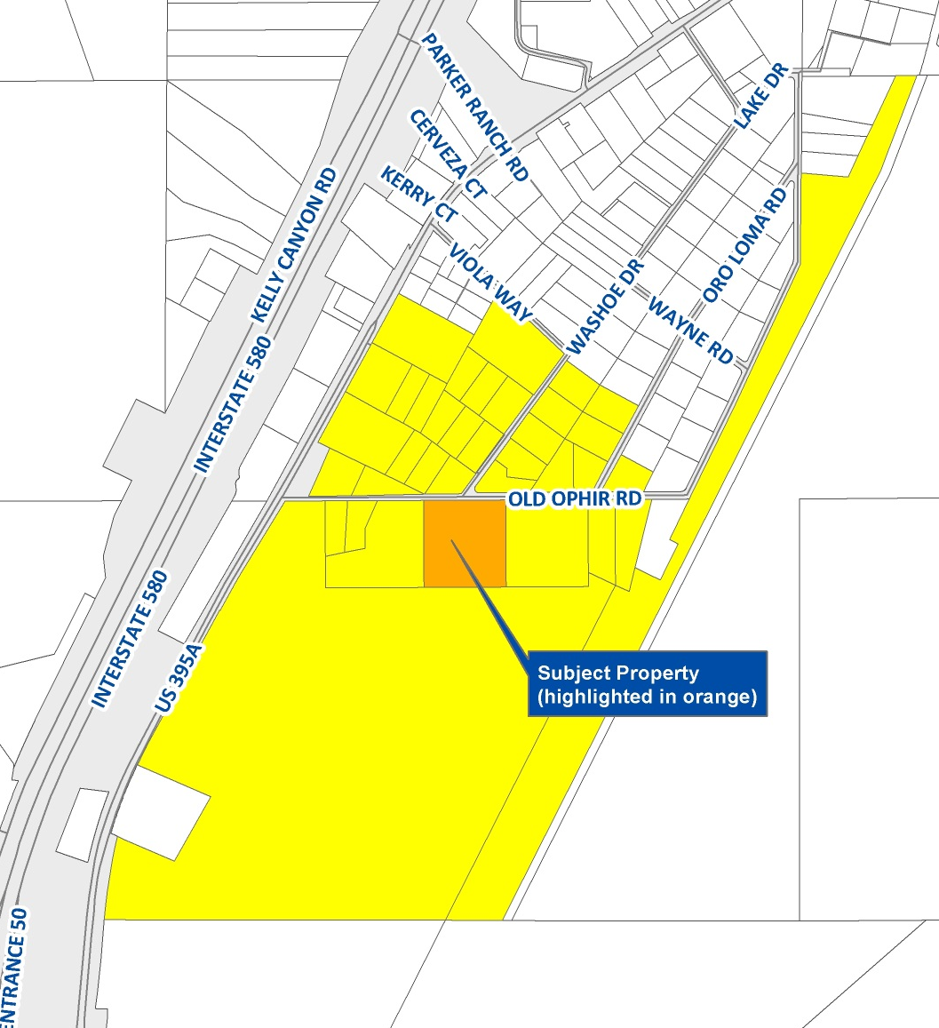
Public Notice
Property owners of 37 parcels within 750 feet of property received notice

Slide 12
CAB and Public Comment
CAB: March 9, 2017 and May 11, 2017
Questions/concerns:
  #horses on property
  Dust control
  Volume of manure
  Water rights
18 letters received: 11 in favor; 7 opposed
Applicant response in Exhibit C
  Impact of smell and traffic
  Airborne disease
  Horse flies
  Emergency evac plans
Notes:
Letters in favor from previous clients
Letters opposed from nearby property owners
Staff believes that stated concerns can be and have been addressed through conditions of approval

Slide 13
Possible Motion
I move that, after giving reasoned consideration to the information contained in the staff report and received during the public hearing, the Washoe County Board of Adjustment approve Special Use Permit Case Number WSUP17-0005 for Lea Ann Canavan, with the conditions attached as Exhibit A to this matter. This includes only a partial approval of the requested reduction to parking and landscaping standards, as identified in Exhibit A. The Board has made all five required findings in accordance with Washoe County Code Section 110.810.30, and the two required findings in accordance with the South Valleys Area Plan.
Notes:
Staff recommending approval of use, and partial approval of landscaping/parking requests, as described in Exhibit A.
With proposed conditions, staff believes impacts can be mitigated and necessary findings can be made.

Slide 14
QUESTIONS?

